Slide 1
Online Ordering System
Aaron Vizzini & Frank Huang

Slide 2
The Project
Provide a system that allows a user to register, sign-in, and order items from a menu.
Created using ASP.NET with C#
Persistence is handled via a SQL Database

Slide 3
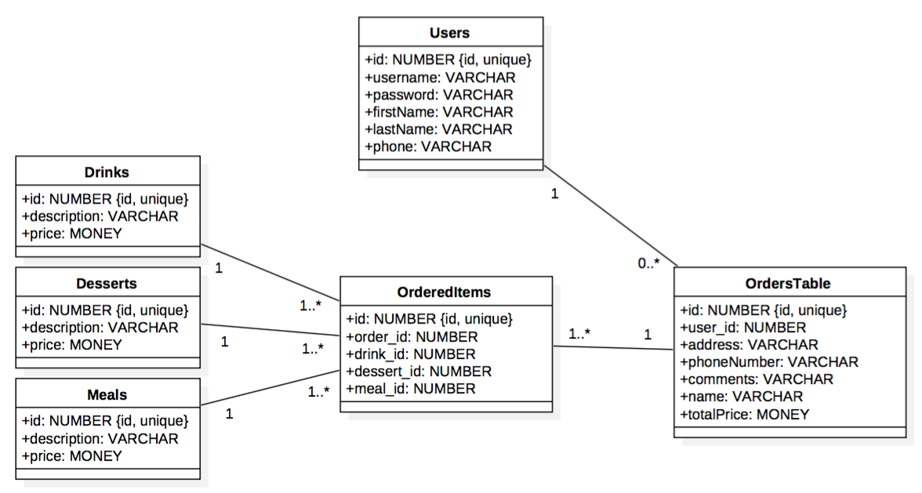
Database Model

Slide 4
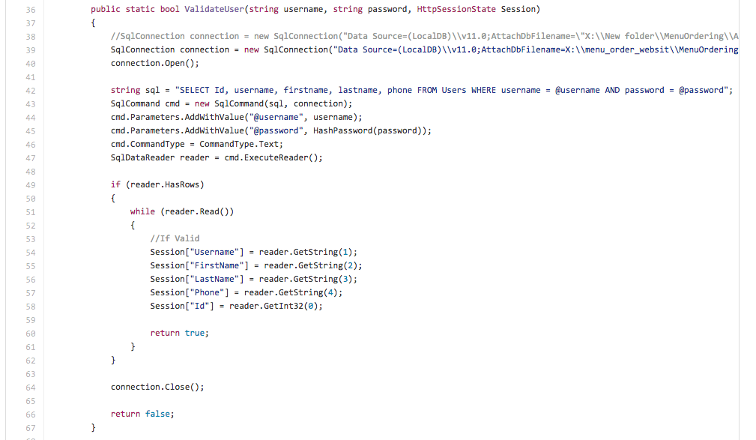
DBManager.cs
This handles all interactions with the DB and the front end operations.

Slide 5
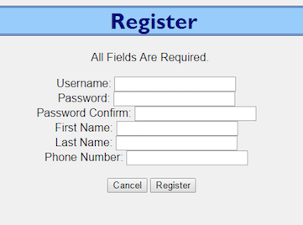
User Registration
Before using the site, a user must register.
They supply a username, password (and confirmation), first name, last name, and phone number.
All fields are required and go through validation (length, matching passwords, etc)
Passwords are stored as a SHA256 hash in the DB.

Slide 6
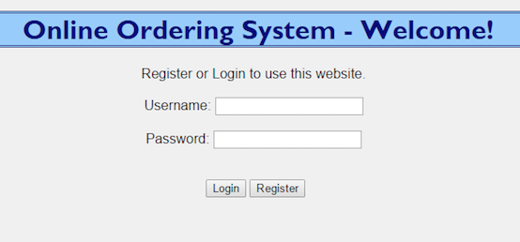
Sign-in
The username provides their credentials for sign.
They click login to login.
If they don’t yet have an account, they can click the register button to direct themselves to the registration page.

Slide 7
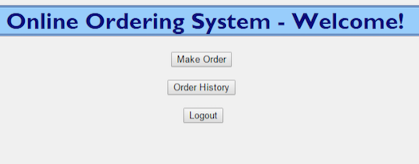
Main Menu
When signed on, the user is directed to the main menu.
They can click the Make Order button to create a new order.
They can click Order History to view their order history.
Or they can logout.

Slide 8
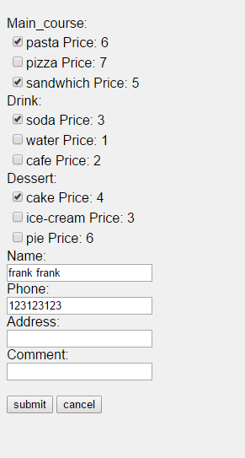
Make an Order
On this page the user can select the drinks, meals, and desserts for their order. All of this require the user is in login state.
They must also supply their name, phone number, address, and any additional comments about the order.
They can then submit the order or cancel the order.
After clicking the submit button, the user will redirect to homepage

Slide 9
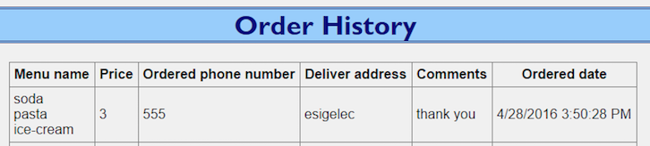
History Page
The history page will simply show all of the previous orders they have made. This shows the items they ordered, their personal information, as well as the order total.

Slide 10
thank you

